Slide 1

COMP90018
Mobile Computing Systems Programming
WEEK 3 – Threads and Service
Weiwei Jiang
weiwei.jiang@student.unimelb.edu.au

Slide 2
1
Threads
2
Service
CONTENTS

Slide 3

Threads (Java)
- Fundamentals

Slide 4
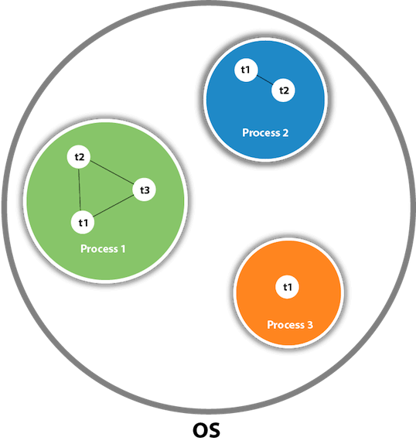
Threads – What is Thread in Java?
A thread is a lightweight subprocess, the smallest unit of processing;
Threads are independent. (If there occurs exception in one thread, it doesn't affect other threads.)
It uses a shared memory area.

Slide 5
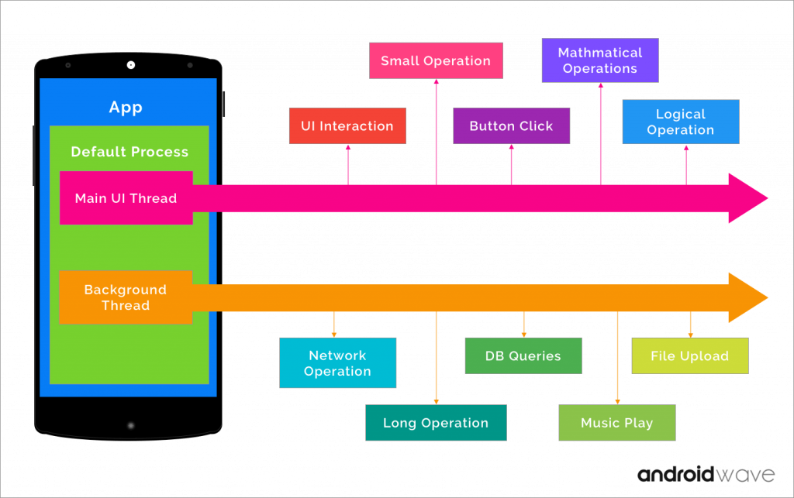
Threads – Why Thread is important?
Multitasking
Multitasking is the concurrent execution of multiple tasks over a certain period of time.
New tasks can interrupt already started ones before they finish, instead of waiting for them to end.

Slide 6
Threads
Android

Slide 7
Threads in Android
By default, all components (activity, service, receiver and provider) of the same application run in the same process and thread (called the "main" thread).
https://developer.android.com/guide/components/processes-and-threads.html
Notes:
If an application component starts and there already exists a process for that application, then the component is started within that process and uses the same thread of execution.

Slide 8
Threads in Android
However, you can create additional threads for any process.

Slide 9
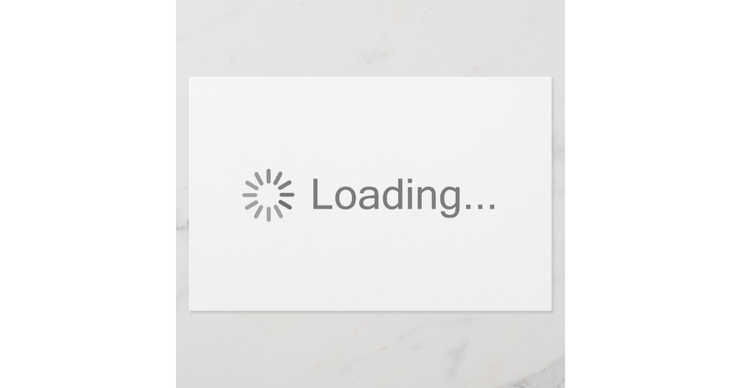
Threads in Android
Two important principles:
Do not block (overburden) the UI thread;

Slide 10
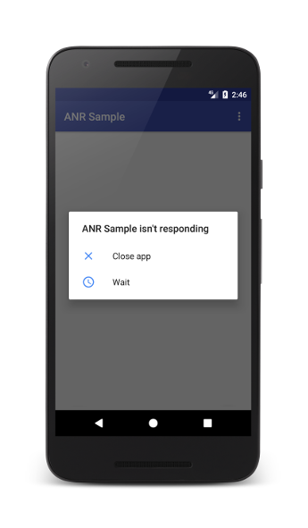
Threads in Android
When the UI thread of an Android app is blocked for too long, an "Application Not Responding" (ANR) error is triggered.
https://developer.android.com/topic/performance/vitals/anr

Slide 11
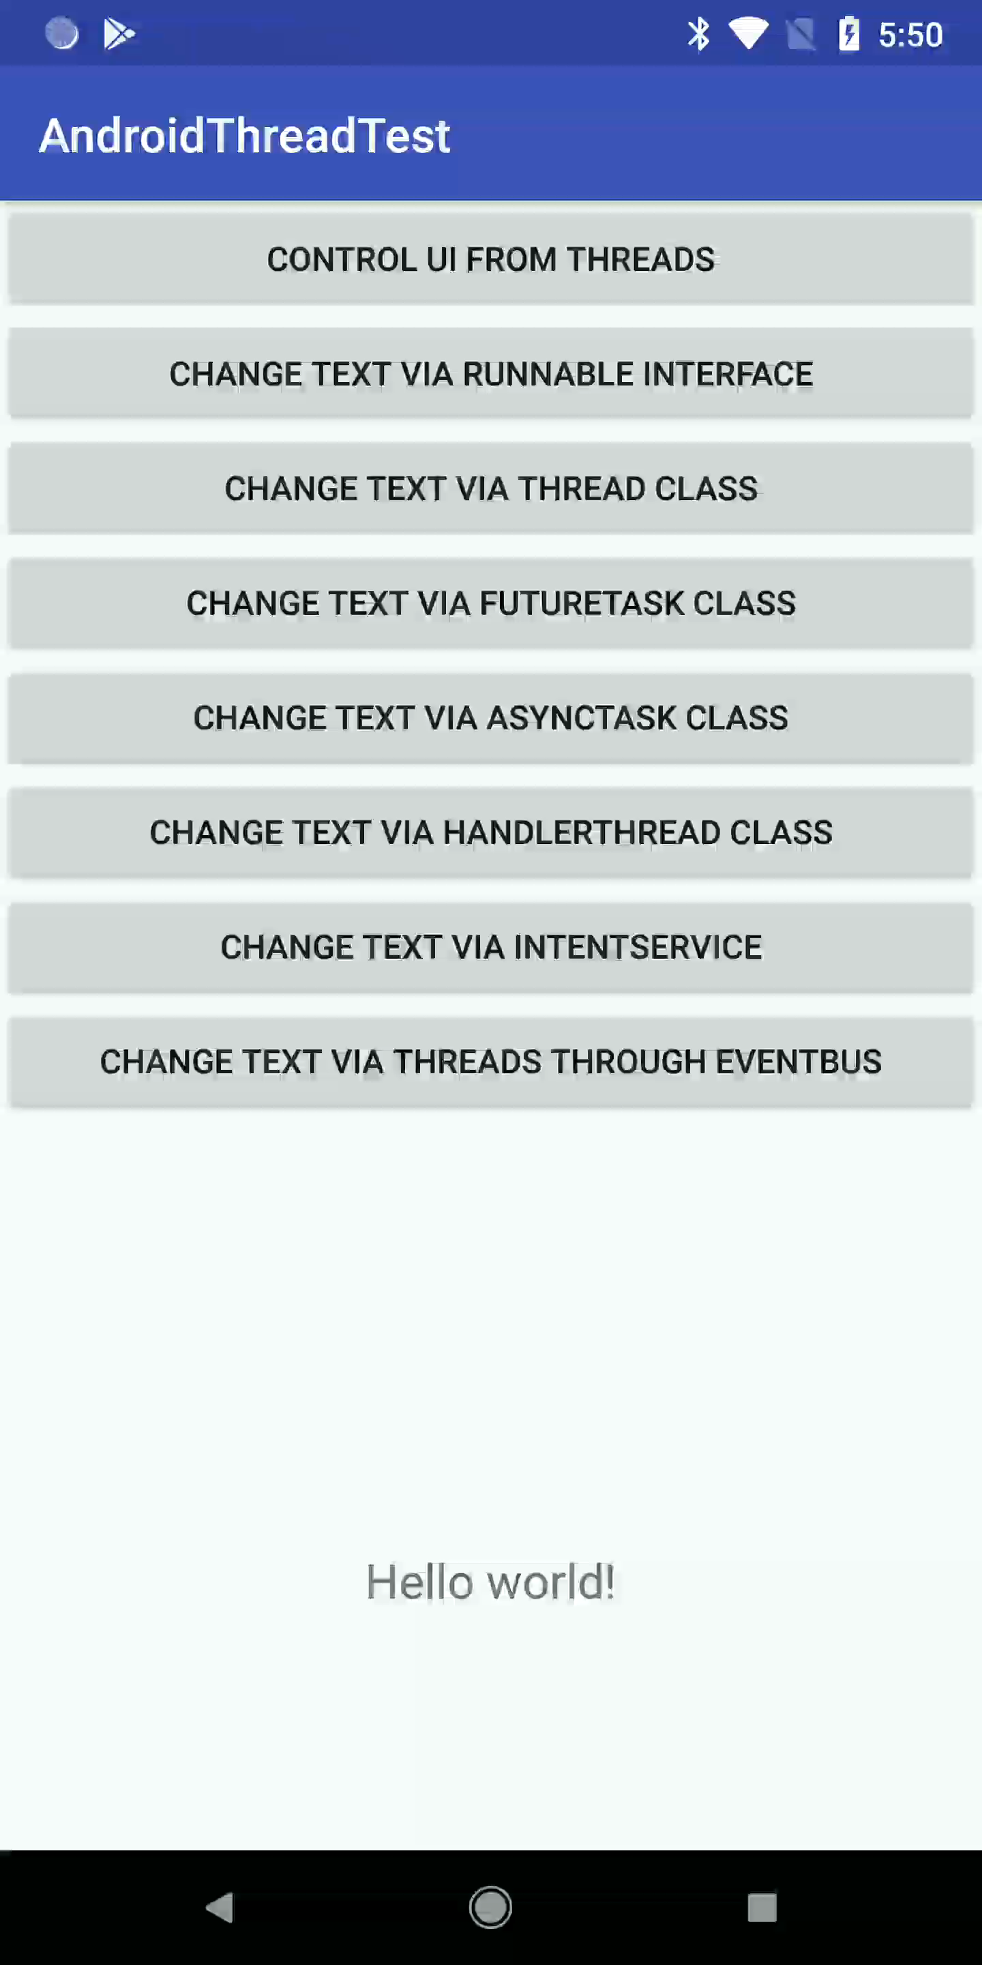
Threads in Android
2. The other important principle comes from:
What will happen when other threads access a TextView from the main (UI) thread?

Slide 12
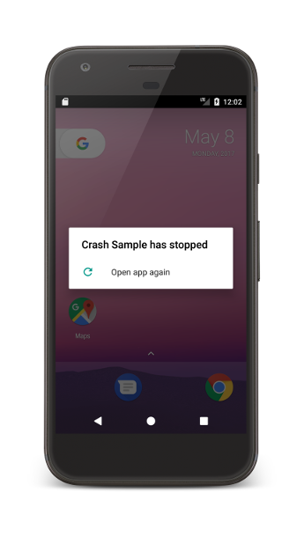
Threads in Android
Do not access UI from outside the UI thread

Slide 13
Threads
Communication between Threads

Slide 14
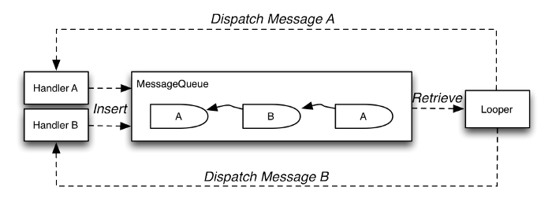
Threads Communication (Message via Handler)
Message;
Handler;
MessageQueue;
Looper

Slide 15
Message
Message:
Defines a message containing a description and arbitrary data object that can be sent to a Handler.
https://developer.android.com/reference/android/os/Message

Slide 16
Handler
Handler:
A Handler allows you to send and process Message associated with a thread's MessageQueue.
Send and post a message: post(), sendMessage(), …;
Process a message: handlerMessage()
https://developer.android.com/reference/android/os/Handler.html

Slide 17
MessageQueue
MessageQueue:
Low-level class holding the list of messages to be dispatched by a Looper.
https://developer.android.com/reference/android/os/MessageQueue.html

Slide 18
Looper
Looper:
Class used to run a message loop for a thread.
Looper is a worker that keeps a thread alive, loops through MessageQueue and sends messages to the corresponding handler to process.
https://developer.android.com/reference/android/os/Looper.html

Slide 19
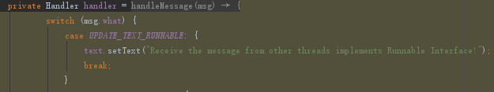
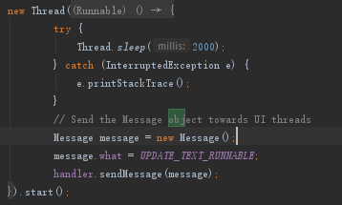
Example
MainActivity.java
Can be anywhere
(when holding handler instance)
Looper does not need to initialize in the main thread.

Slide 20
Threads
Communication between Threads (EventBus, for reading)

Slide 21
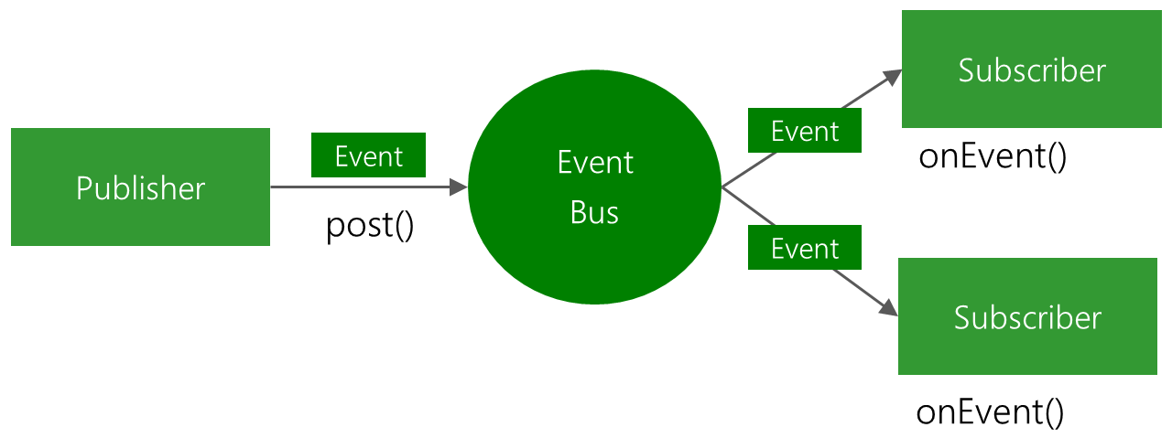
Threads Communication (EventBus)
EventBus is an open-source library for Android and Java using the publisher/subscriber pattern for loose coupling.
http://greenrobot.org/eventbus/
https://github.com/greenrobot/EventBus

Slide 22
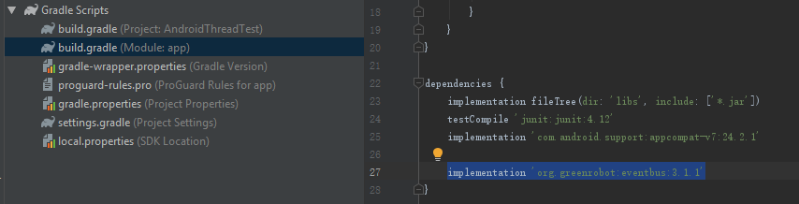
EventBus –Library Setting
build.gradle(app level)

Slide 23
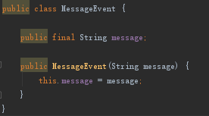
EventBus
Step 1: Define events
Events are POJO (plain old Java object) without any specific requirements.
MessageEvent.java

Slide 24

EventBus
Step 2: Prepare subscribers
Subscribers implement event handling methods (also called “subscriber methods”) that will be called when an event is posted.
These are defined with the @Subscribe annotation.
MainActivity.java

Slide 25
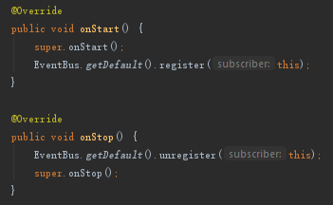
EventBus
Step 2: Prepare subscribers
Subscribers also need to register themselves to and unregister from the bus. Only while subscribers are registered, they will receive events.
In Android, in activities and fragments you should usually register according to their life cycle.
MainActivity.java

Slide 26
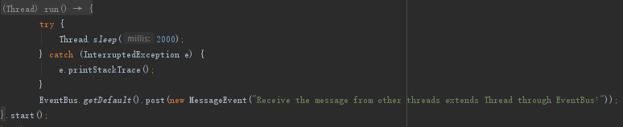
EventBus
Step 3: Post events
Post an event from any part of your code.
All currently registered subscribers matching the event type will receive it.
Can be anywhere

Slide 27
Threads
Implements in Android

Slide 28
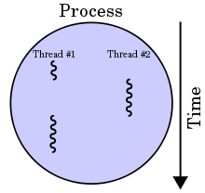
Implements
Thread/Runnable
FutureTask
AsyncTask
HandlerThread
IntentService
……

Slide 29
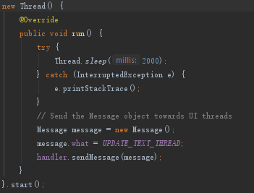
Implements – Thread
Subclass of Thread
Declare a class to be a subclass of Thread. This subclass should override the run method of class Thread.
https://developer.android.com/reference/java/lang/Thread

Slide 30
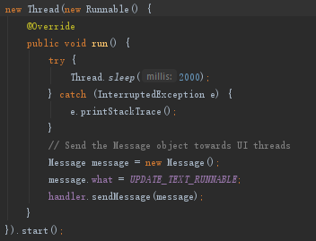
Implements – Runnable
Implements the Runnable interface
Create a thread is to declare a class that implements the Runnable interface. That class then implements the run method.
Use Runnable if you are only planning to override the run() method.
https://developer.android.com/reference/java/lang/Thread

Slide 31
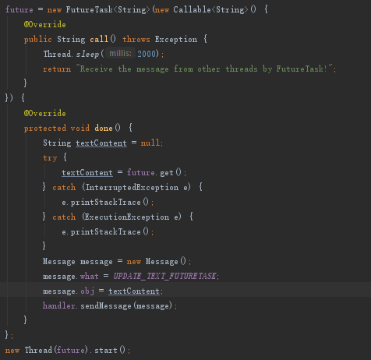
Implements – FutureTask
Thread with FutureTask
This class provides a base implementation of Future, with methods to start and cancel a computation, query to see if the computation is complete, and retrieve the result of the computation.
https://developer.android.com/reference/java/util/concurrent/FutureTask

Slide 32
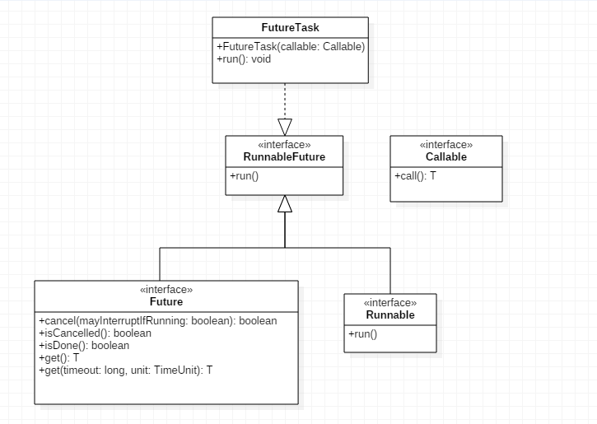
For Reading
Callable
https://developer.android.com/reference/java/util/concurrent/Callable
Future
https://developer.android.com/reference/java/util/concurrent/Future
RunnableFuture
https://developer.android.com/reference/java/util/concurrent/RunnableFuture
FutureTask
https://developer.android.com/reference/java/util/concurrent/FutureTask

Slide 33
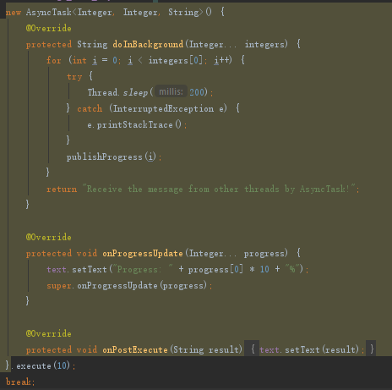
Implements – AsyncTask
Instance of AsyncTask
(Deprecated in API level 30, but still usable for now)
This class allows you to perform background operations and publish results on the UI thread without having to manipulate threads and/or handlers.
e.g., downloading a file while updating a progress bar.
https://developer.android.com/reference/java/lang/Thread

Slide 34
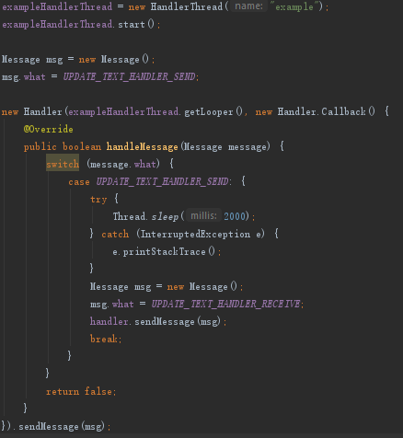
Implements – HandlerThread
Instance of HandlerThread
A Thread that has a Looper (i.e., message loop). The Looper can then be used to create Handlers.
(Note that just like with a regular Thread, Thread.start() must still be called.)
https://developer.android.com/reference/java/lang/Thread

Slide 35
For Reading – Thread Guide
Making adept use of threads on Android can help you boost your app’s performance.
The page discusses several aspects of working with threads:
working with the UI, or main, thread;
the relationship between app lifecycle and thread priority;
methods that the platform provides to help manage thread complexity.
https://developer.android.com/topic/performance/threads

Slide 36
For Reading – ThreadPoolExecutor
To automatically run tasks as resources become available, or to allow multiple tasks to run at the same time (or both), you need to provide a managed collection of threads.
To do this, use an instance of ThreadPoolExecutor, which runs a task from a queue when a thread in its pool becomes free. To run a task, all you have to do is add it to the queue.
ExecutorService executor = new ScheduledThreadPoolExecutor(2);
executor.execute(Thread implement runnable or override run() method);
https://developer.android.com/training/multiple-threads/create-threadpool.html

Slide 37
Service

Slide 38
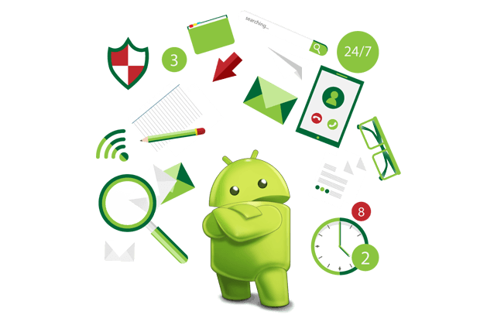
Service – What is Service in Android?
A Service is an application component that can perform long-running operations in the background, and it doesn't provide a user interface.
Note: “long-running” does not mean forever.
https://developer.android.com/guide/components/services

Slide 39
Service
Create Service

Slide 40
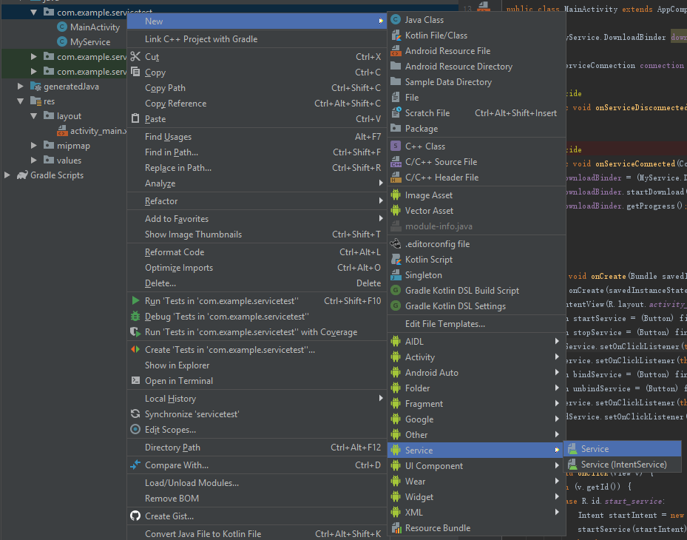
Create Service
If you do use a service, it still runs in your application's main thread by default, so you should still create a new thread within the service if it performs intensive or blocking operations.
However, it is possible to create service in another process by changing android:process.

Slide 41
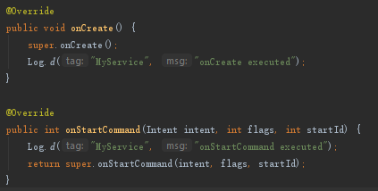
Create Service
Start a Service
The system invokes this method by calling startService() when another component (such as an activity) requests that the service be started.
When this method executes, the service is started and can run in the background.
MyService.java
MainActivity.java

Slide 42
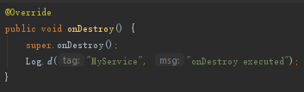

Create Service
Stop a Service
The system invokes this method when the service is no longer used and is being destroyed by invoking stopService().
Your service should implement this to clean up any resources such as threads, registered listeners, or receivers.
MyService.java
MainActivity.java

Slide 43
Service
Bind Service

Slide 44
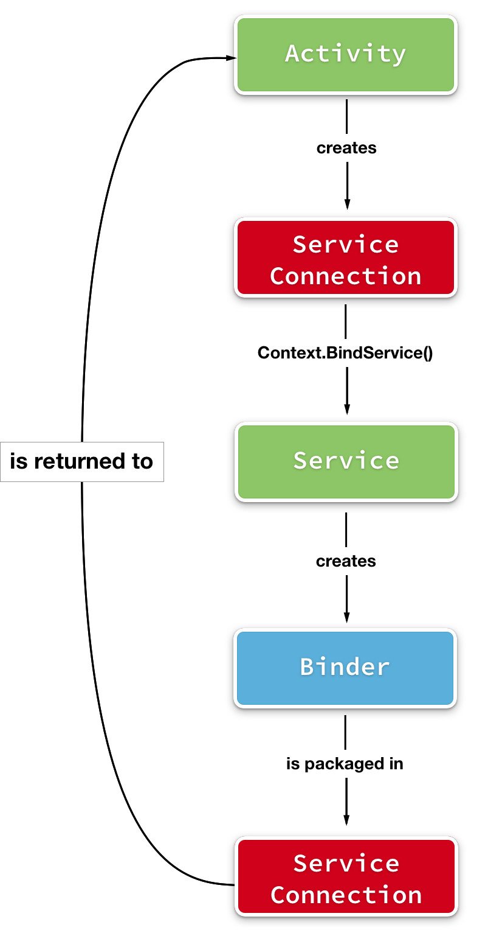
Bind Service
A service is bound when an application component binds to it by calling bindService().
A bound service offers a client-server interface that allows components to interact with the service, send requests, receive results, and even do so across processes with interprocess communication (IPC).

Slide 45
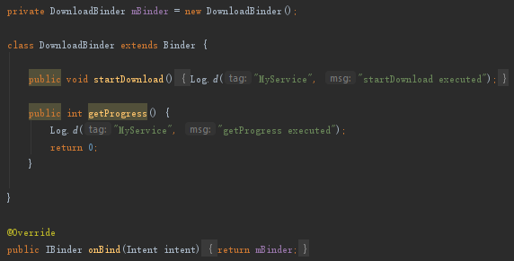
Bind Service
To create a bound service, implement the onBind() callback method to return an IBinder that defines the interface for communication with the service.
MyService.java

Slide 46
Bind Service
To create a bound service, you must define the interface that specifies how a client can communicate with the service.
This interface between the service and a client must be an implementation of IBinder and is what your service must return from the onBind() callback method.
MyService.java

Slide 47
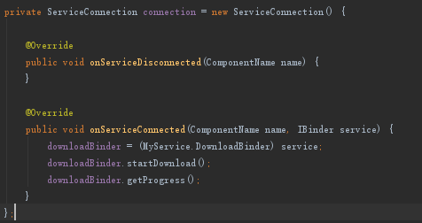
Bind Service
When binding a service, the called component must provide an implementation of ServiceConnection, which monitors the connection with the service.
MainActivity.java

Slide 48
Bind Service
A client binds to a service by calling bindService().
A client unbinds to a service by calling unbindService().
MainActivity.java
MainActivity.java

Slide 49
Service
Life Cycle Difference between Start and Bind Service

Slide 50
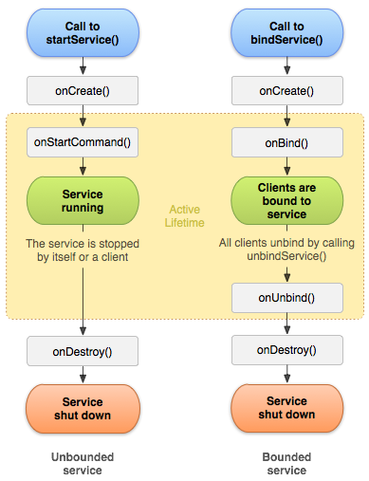
Life Cycle of Service
A started Service
The service is created when another component calls startService().
The service then runs indefinitely and must stop itself by calling stopSelf(). Another component can also stop the service by calling stopService().
When the service is stopped, the system destroys it.

Slide 51
Life Cycle of Service
A bound Service
The service is created when another component (a client) calls bindService(). The client then communicates with the service through an IBinder interface.
The client can close the connection by calling unbindService().
Multiple clients can bind to the same service and when all of them unbind, the system destroys the service. The service does not need to stop itself.

Slide 52
Life Cycle of Service
Although the figure separates services that are created by startService() from those created by bindService(), keep in mind that any service, no matter how it's started, can potentially allow clients to bind to it.

Slide 53
Service
Communicate between Service and other Components (for reading)

Slide 54
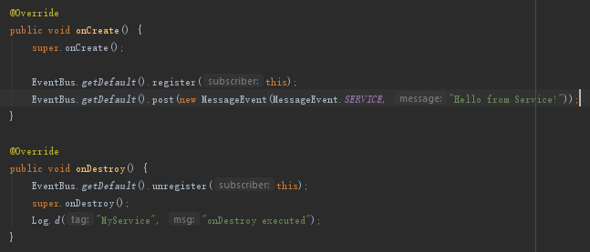
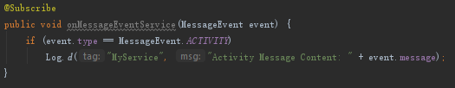
EventBus
Service Side
MyService.java
MyService.java

Slide 55
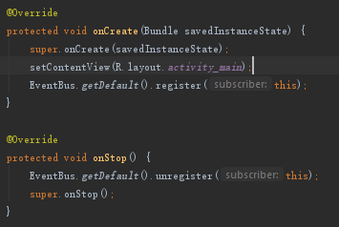
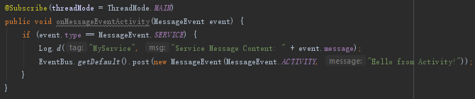
EventBus
Activity Side
MainActivity.java
MainActivity.java

Slide 56
EventBus – Result

Slide 57
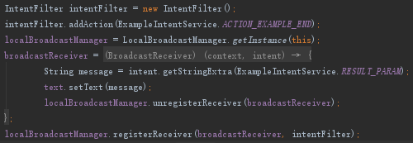

Broadcast Intent
Any Service.java
MainActivity.java

Slide 58

For Reading – Broadcast
Android apps can send or receive broadcast messages from the Android system and other Android apps.
These broadcasts are sent when an event of interest occurs, such as when the system boots up or the device starts charging.
https://developer.android.com/guide/components/broadcasts

Slide 59
For Reading – Binder
Three method to create the interface:
Extending the Binder Class
https://developer.android.com/guide/components/bound-services#Binder
Using a Messenger
https://developer.android.com/guide/components/bound-services#Messenger
Using AIDL
https://developer.android.com/guide/components/aidl.html
When creating a service that provides binding, you must provide an IBinder that provides the programming interface that clients can use to interact with the service.
https://developer.android.com/guide/components/bound-services#Messenger

Slide 60
Service
Foreground Service

Slide 61
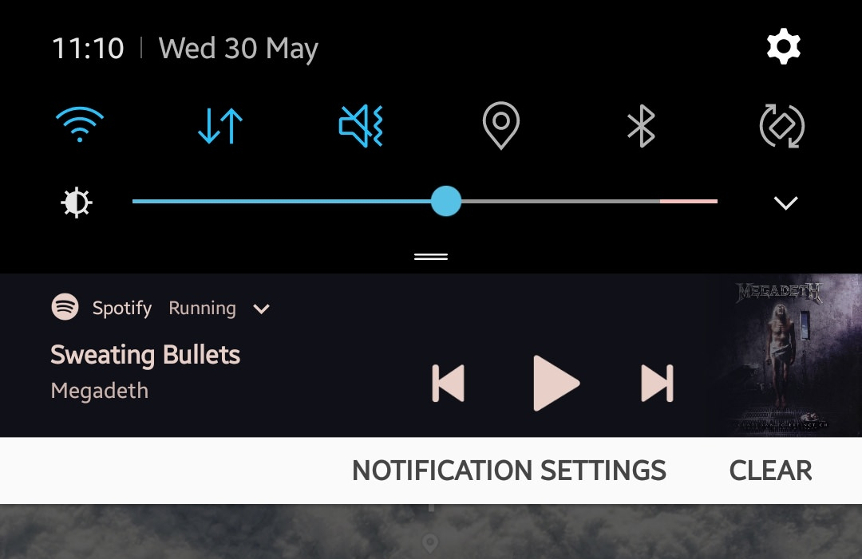
Foreground Service
A foreground service performs some operation that is noticeable to the user. (For example, an audio app would use a foreground service to play an audio track.)
Foreground services must display a Notification.
Since Android 8 (API level 26), you should use foreground service for running your app indefinitely.
https://developer.android.com/guide/components/services

Slide 62
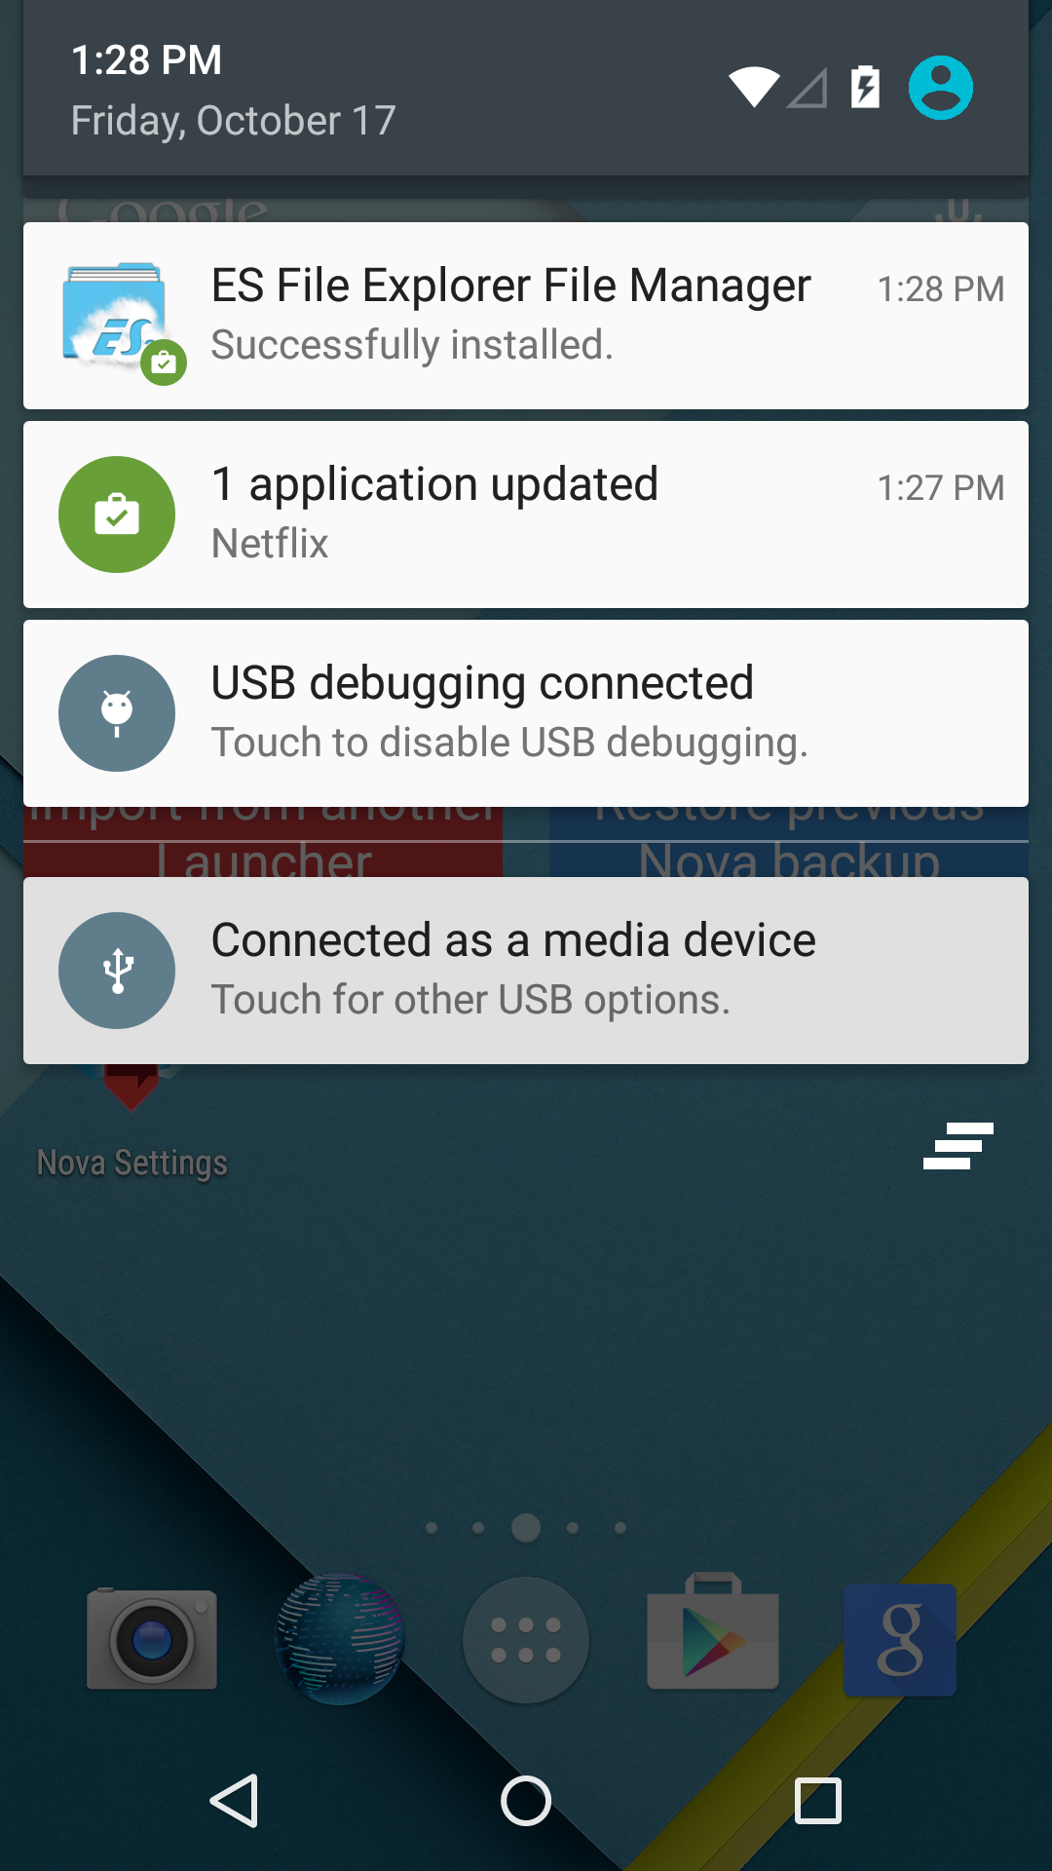
For Reading – What is a notification?
A notification is a message that Android displays outside your app's UI to provide the user with reminders, communication from other people, or other timely information from your app.
Users can tap the notification to open your app or take an action directly from the notification.
https://developer.android.com/guide/topics/ui/notifiers/notifications

Slide 63
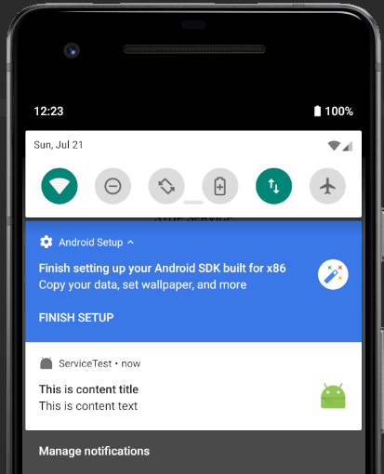
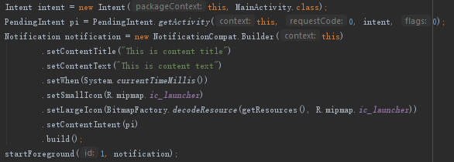
Foreground Service - Code
MyService.java

Slide 64
Service
IntentService

Slide 65
IntentService
IntentService is a base class for Services that handle asynchronous requests (expressed as Intents) on demand.
Deprecated in API Level 30, but still usable.
Clients send requests through Context.startService(Intent) calls; the service is started as needed, handles each Intent in turn using a worker thread, and stops itself when it runs out of work.
https://developer.android.com/reference/android/app/IntentService

Slide 66
For Reading – IntentService vs AsyncTask
IntentService allows it to handle long-running operations without affecting your user interface's responsiveness.
IntentService isn't affected by most user interface lifecycle events, so it continues to run in circumstances that would shut down an AsyncTask.
https://developer.android.com/training/run-background-service/create-service

Slide 67
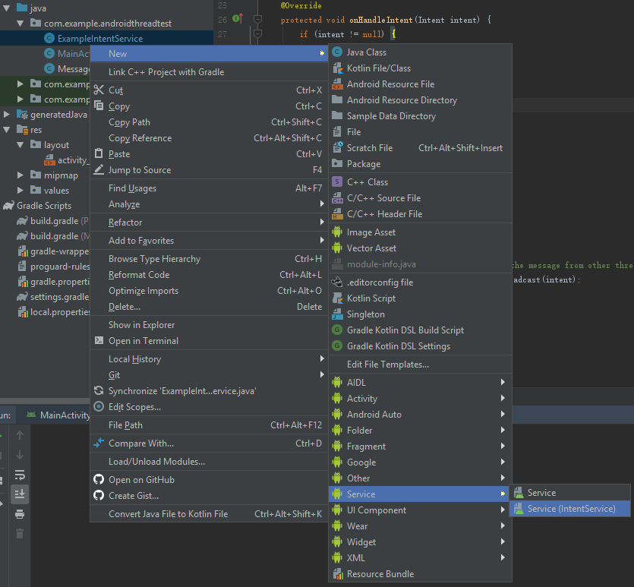
IntentService – Create

Slide 68
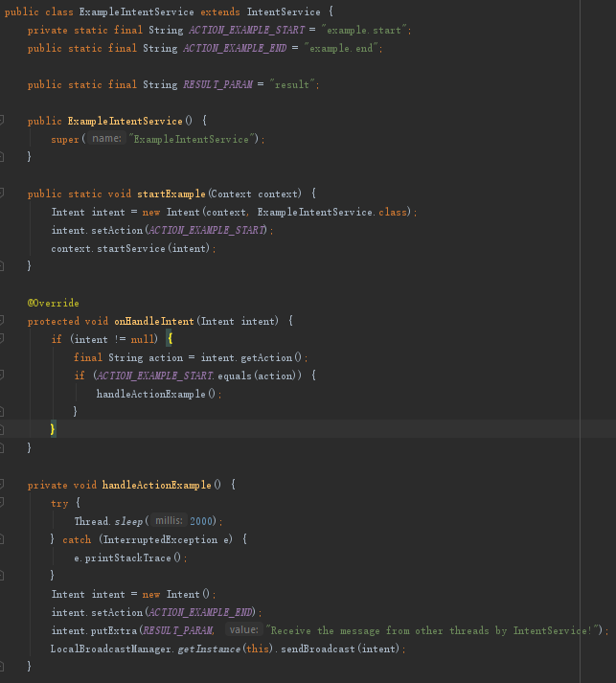
IntentService – Code
MainActivity.java
ExampleIntentService.java

Slide 69
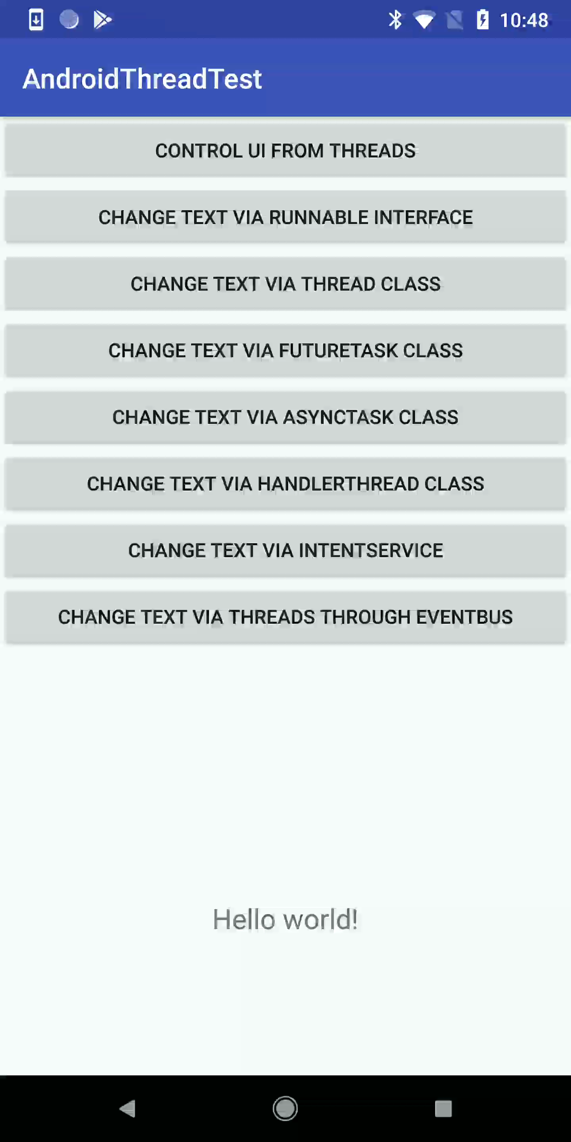
IntentService – Result

Slide 70
Please re-join the zoom meeting
if you come early for the next tutorial.

